Slide 1

www.thegemini.co.in
HEALTHCARE
CUSTOMER RELATIONSHIP MANAGEMENT SYSTEM
Build meaningful and lasting patient relationships

Slide 2
WELCOME TO
THE GEMINI

Slide 3



ABOUT THE GEMINI
Headquartered in Ahmedabad, India, The Gemini is a leading Global Enterprise Software Provider with a reputation for Innovative Products and Outstanding Services. The company provides enterprise software solutions to multiple verticals, including Healthcare, Education, Corporate Houses, Public sector and more. Our experienced staff of professionals has worked with a wide array of platforms , languages, and tools in the course of our various projects

Slide 4


WHY – THE GEMINI ?
Global Presence.
State-of-the-art infrastructure.
Proven offshore outsourcing model.
Multi-cultural & Multi-location understanding
Quick turnaround time.
Consistent growth & performance.
Localize existing software for use in other countries & markets.
Domain knowledge. Easy access to the team in India.
Flexible to work with the needs of the client.
High-quality and cost-effective services
Diverse teams of highly qualified IT Professionals
Latest software and technologies
One-stop-shop for all IT needs
Proven infrastructure to provide 24x7 supports globally.

Slide 5


SOCIAL MEDIA
HEALTHCARE MARKETING IS CHANGING
Hospitals are very competitive.
Hospitals are moving from mass advertising to targeted direct marketing
Different offers, creative and techniques are used in direct mail to attract prospects to the facility.
Hospitals are developing “customer outreach” databases and are using traditional direct marketing techniques.

Slide 6
HEALTHCARE CRM MARKET: KEY TRENDS
The global market for CRM is expected to grow at a steady rate over the forecast period owing to the rising demand for automation for the purpose of documentation and the need for a single platform for information exchange. The adoption of healthcare CRM is likely to be triggered by the advancements in technology in the field of Information Technology and communication. The growing demand form patients in order to acquire early treatment through means such as disease monitoring systems, mobile monitoring, and home care is expected to bode well for the growth of the market over the coming years. Healthcare CRM also caters to several requirements of both patients and service provider such as collaborative services, chronic disease management, predictive services, database construction, communication services, and management and coordination.

Slide 7
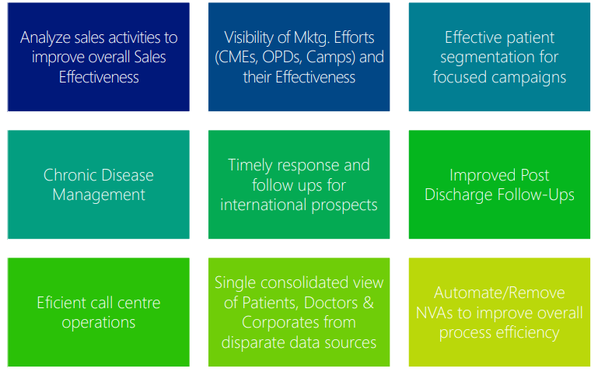
KEY HOSPITAL NEEDS

Slide 8

WHAT IS CRM ?
The Gemini CRM is an integrated approach that uses today’s technology to collate information from all diverse channels- sales, marketing, customer care, field service.
A healthcare CRM is a customer relationship management system designed specifically for use by healthcare organizations. The Gemini Healthcare CRMs weave together multiple sources of data (consumer and patient demographics, psychographics, social, behavioral, clinical, financial, website, call center, provider credentialing, etc.) to provide a comprehensive view into patient habits and activities. The primary goal of a The Gemini healthcare CRM system is to engage, acquire, and retain patients.

Slide 9
WHY CRM FOR HEALTHCARE
Till recently, doctors would not pay much heed to either marketers or marketing, but not anymore, especially after the advent of customer relationship management or CRM solutions for healthcare, which assimilates operational processes and improves customer relations for maximized efficiency. With an ever increasing number of patients and their growing personal and confidential information, records and referrals, healthcare providers have a lot to handle and organize in order to succeed. This valuable data is critical to provide good customer care and helps in maintaining fruitful connection with them. The Gemini Healthcare CRM system not just collaborates and collates all the customer information for efficient patient management, it also automates processes and streamlines inter-departmental functioning, thus justifying company’s investment in a CRM software.

Slide 10



WHY CRM FOR HEALTHCARE
All-round profiling of prospective and current patients
Outcome-focused management of referring providers
Facilitation of pre- and post-treatment communication with patients
Measurable patient experience
Web content personalization based on website-CRM-EHR interaction
Email marketing automation
MICHAEL WILSON

Slide 11
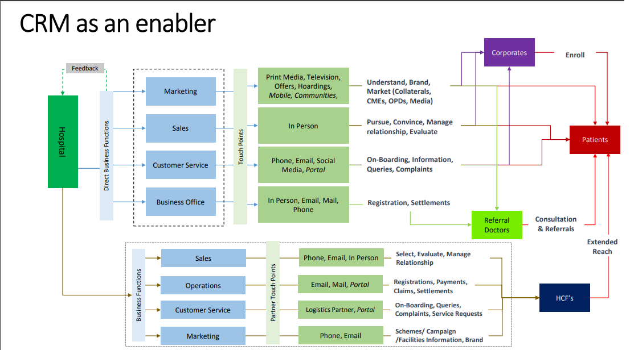

Slide 12
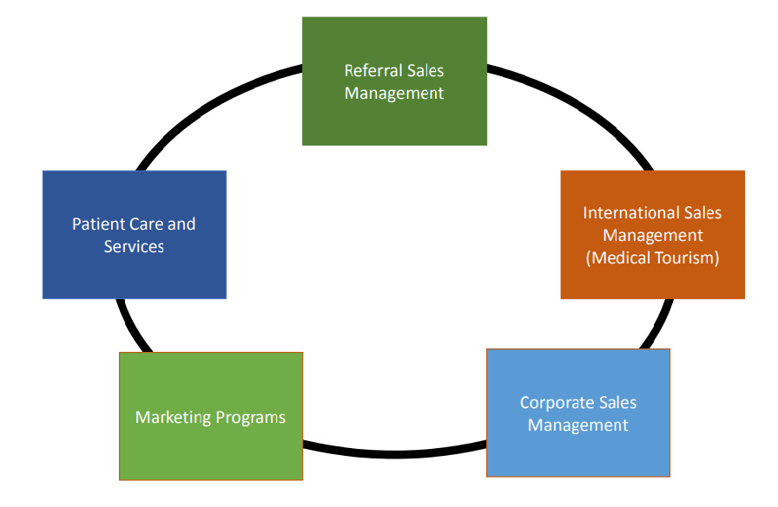
HEALTHCARE CRM FUNCTIONALITIES

Slide 13
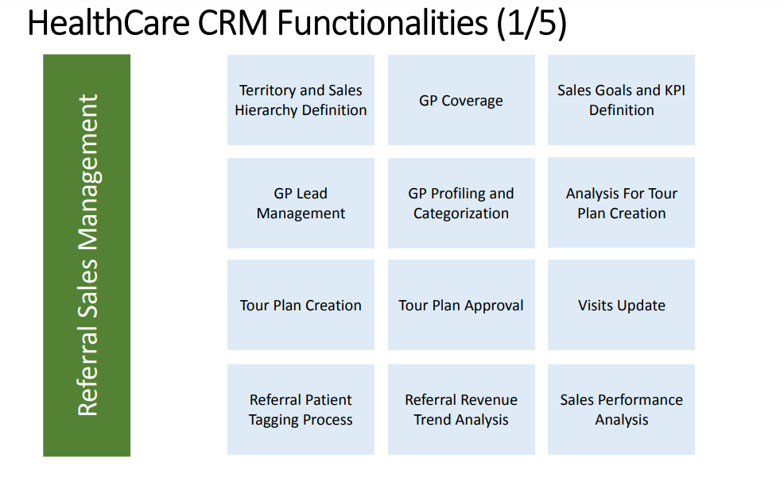

Slide 14
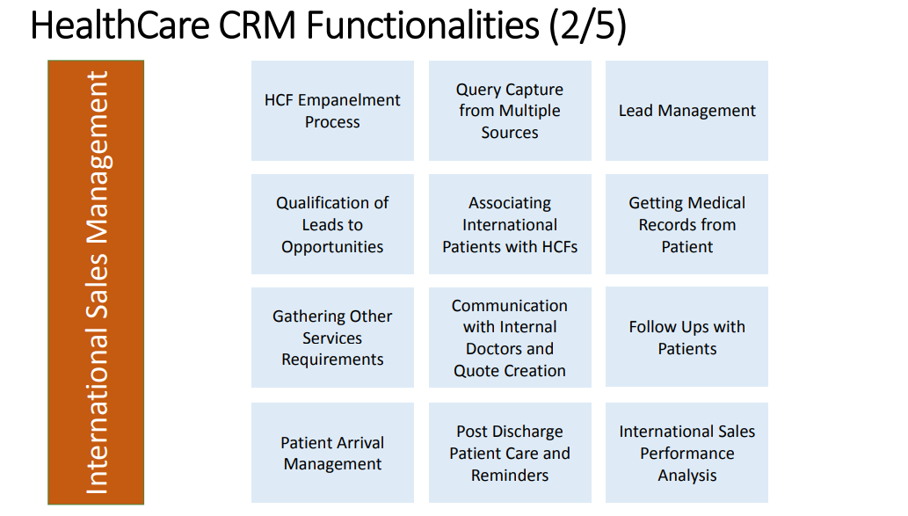

Slide 15
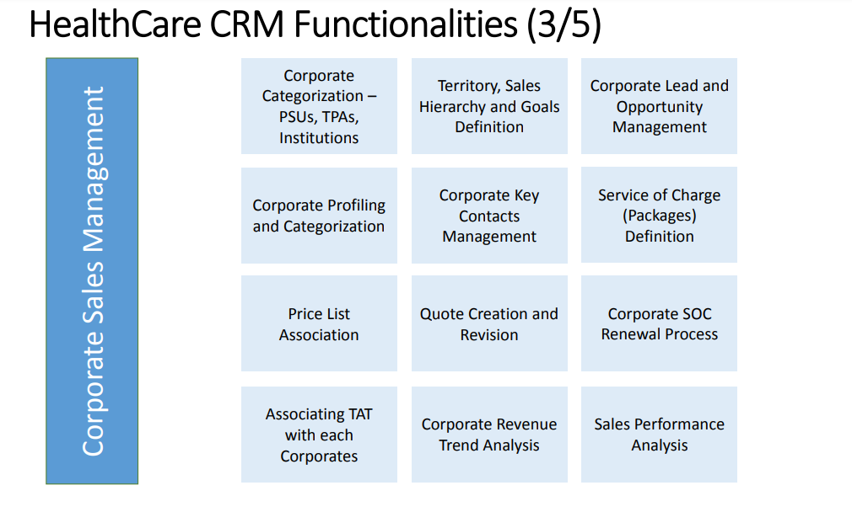

Slide 16
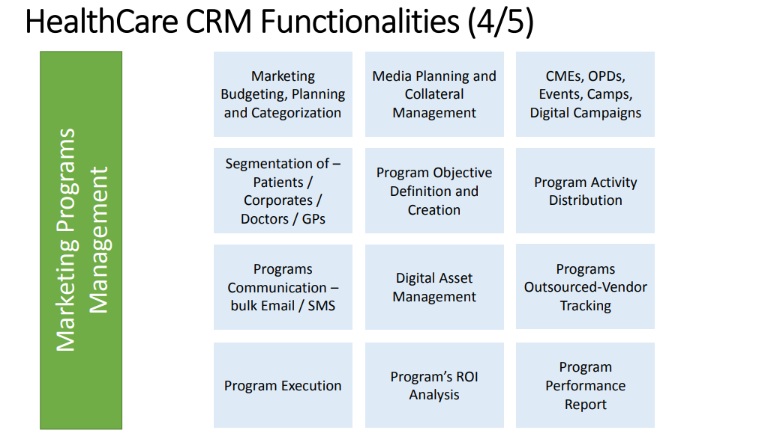

Slide 17
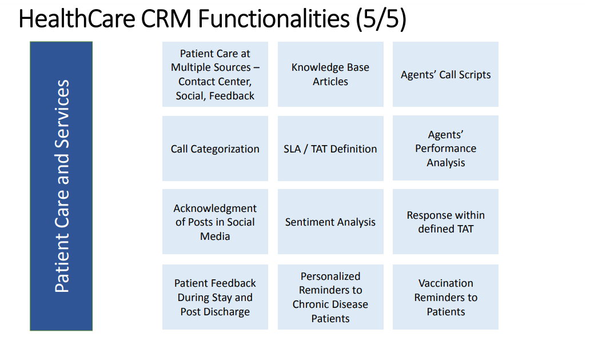

Slide 18
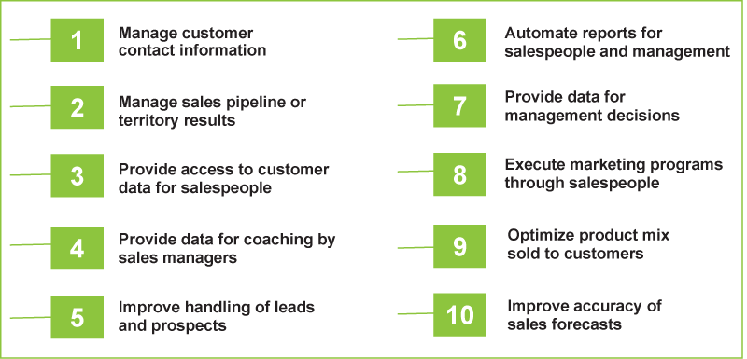
FEATURES

Slide 19

PRODUCT FEATURES
Centralized Multi City Appointments
Lead Management ( Boost leads conversion)
Cloud Telephony Integration
Patient Data Management
Electronic Medical Record (EMR)
Billing (Advanced)
Pharmacy & Inventory (Multi-location)
Prescription Templates
Consultant Association Network
MultiClinic Support & SaaS Based
High End Security control on Data
Medical Equipment Management
Referral Management
Real Time Analytics
Comprehensive Reports
Loyalty Program
Patient Membership Management
Mobile Application
Post Treatment Connect
Leave Management
Track Expenses
Text
Text
Text
Text

Slide 20
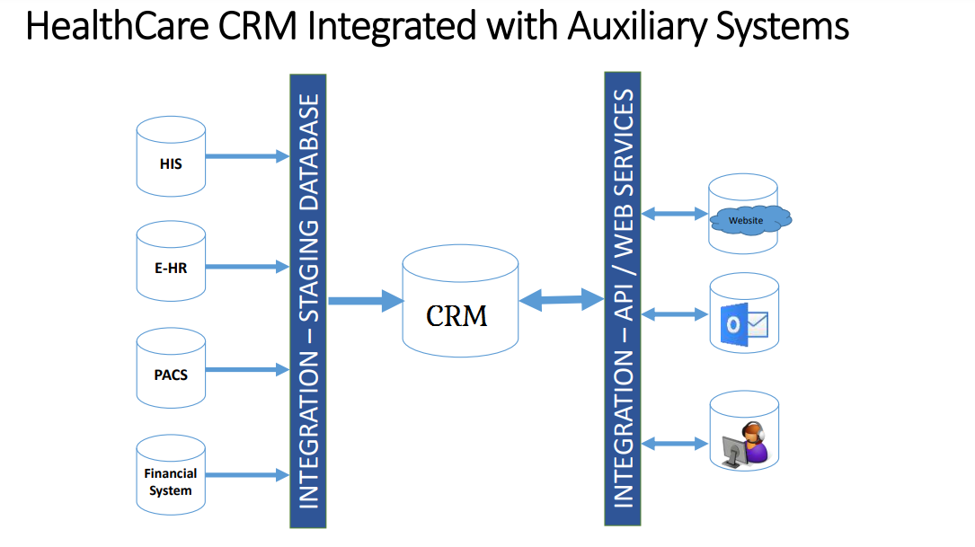

Slide 21
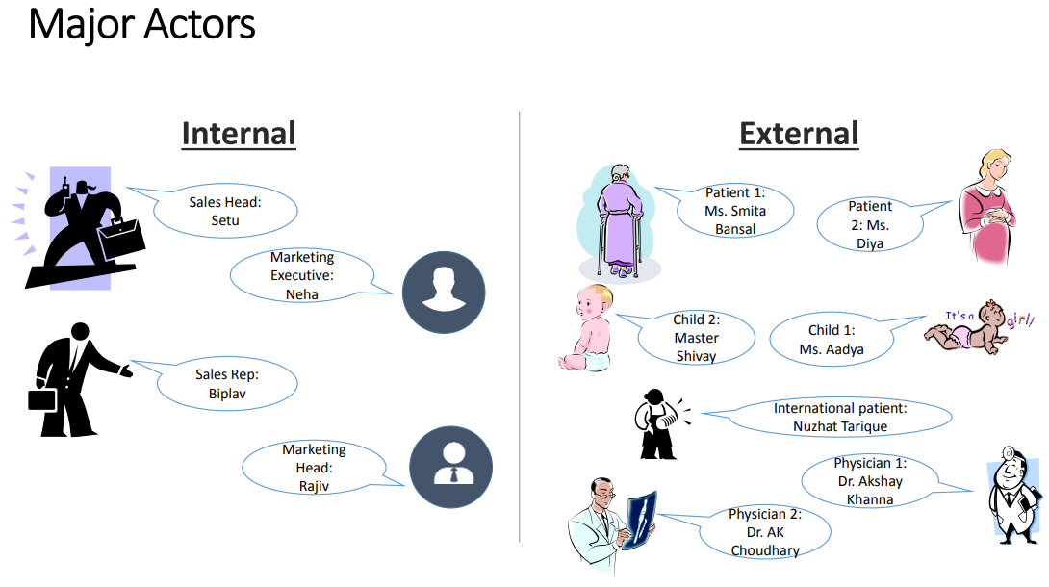

Slide 22
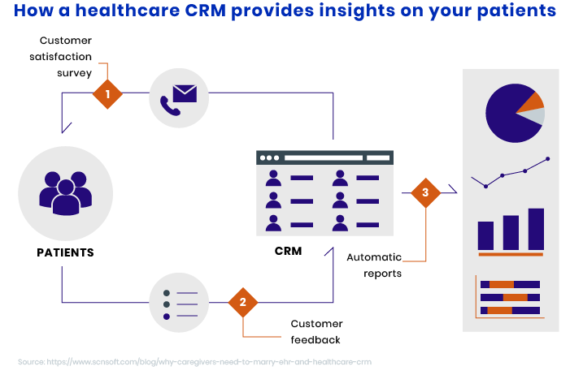

Slide 23
BENEFITS OF USING THE GEMINI CRM
INCREASED REVENUE
Improve Customer Retention
Attract New Customers
Up Sell – Cross Sell
DECREASED COSTS
Automate T asks
Improve Campaign Efficiency
Improve Forecast Accuracy and Timeliness
INTANGIBLES
Increase Customer Satisfaction
Improve Product and Pricing Models
Increase Knowledge Retention
Differentiate yourself in the Marketplace
Increase your Understanding of your Customers

Slide 24
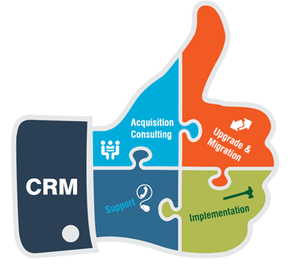

CRM PROCESS
First map your hospital processes – from entry of patient in the hospital to final discharge from the hospital
Integrate it in the existing operational systems
Build a functional and technical team- a cross functional team with vertical industry knowledge, it skills and project management capabilities
Business intelligence out of these data
Data collection/ data transformation
Data storage
Presentation after analysis

Slide 25
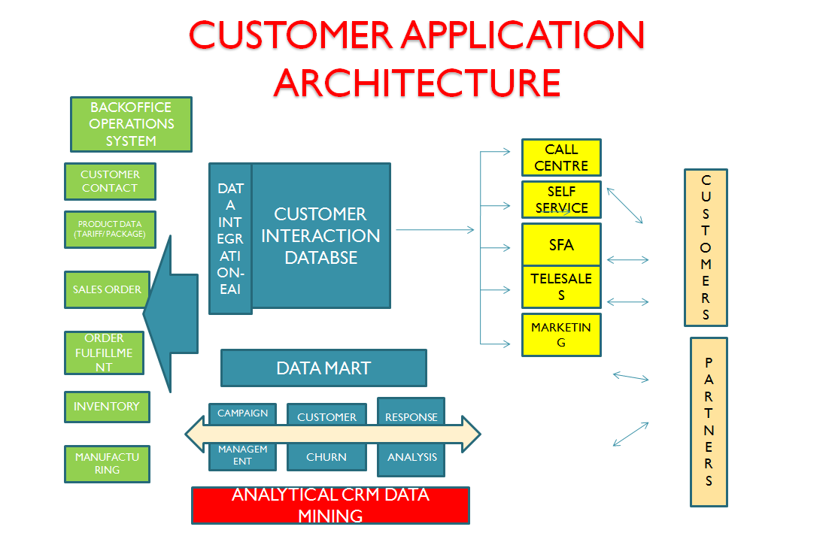

Slide 26

HOW WE HELP ?
FULL-CYCLE COMPETENCIES: We start with CRM consulting and a free proof-of-concept to align your expectations and requirements. We then take you through the project stages, from Business Analysis to Maintenance, with minimum efforts on your side.
MULTI-PLATFORM CRM: We have the resources and expertise to deliver healthcare CRM solutions across desktop, web and mobile platforms, including cloud-based options.
INTEGRATION: We integrate CRM solutions with existing enterprise-level systems such as EHR and patient support facilities (online appointment booking, patient portals, live chat, call center).

Slide 27




At The Gemini, we work up and customize CRM systems with the following operating procedures:
PATIENT DATABASE helps to gain and retain all the client-, patient- and employee-oriented information and keep it in common access for more essential and well-coordinated client approach.
CONTACT MANAGEMENT SERVICE is an excellent system for storing the contacts.
CONTACT APPOINTMENT PLANNER fixates the time and place of various medical procedures for all the patients and assists to plan further examinations and tests.
TARIFF MANAGEMENT SYSTEM allows to operate and modulate the cost of medical services.
BILLING SYSTEM helps to manage the expenses and presents the patients with the bills.

Slide 28




At The Gemini, we work up and customize CRM systems with the following operating procedures:
ENTERPRISE CONTENT MANAGEMENT SYSTEM enables to control and use all the patients’ electronic records.
DOCUMENT MANAGEMENT AND ARCHIVATION allows to keep all necessary documentation at one server with public and easy access to it anytime.
INTEROPERATION WITH OTHER PROGRAMS helps to swap information with all types of systems and applications.
BACK OFFICE PROJECT ACCOUNTING SYSTEM is a special feature which allows handle the documents and quickly generate patient lists, control operations and check-in process, analyze the level of patient care and marketing effectiveness.
PROACTIVE MANAGED CARE PROGRAMS help to schedule all the healthcare facilities and procedures for patients, subscribed to various wellness programs, medical inspection programs and chronically ill ones.

Slide 29
OUR
LOCATIONS:
DEVELOPMENT CELL : Ahmedabad, Ajmer, Kolkata
TECHNICAL SUPPORT : Udaipur, Mumbai, Bangalore, Noida, Pune, Kolkata, Bhubaneswar
BUSINESS ADDRESS : Berlin, Germany
THE GEMINI PARTNER : Nigeria, Kenya, Uganda, UAE, Trinidad

Slide 30




To Discuss Your Needs Or For A Comprehensive Demonstration Of The Any The Gemini Product Or Service Contact Us :
+91 9265562676
consultants@thegemini.co.in
www.thegemini.co.in
thegemini-india

Slide 31
Thank You
We are always interested in exploring new projects, so if you’re interested in discussing your particular development challenges with us, please contact us at: The Gemini. We’re confident that our staff of experienced professionals can be a valuable addition to your team.

